Slide 1
URS WinForm 監聽架構
2021/12/223
Michael

Slide 2
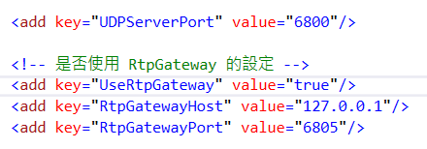

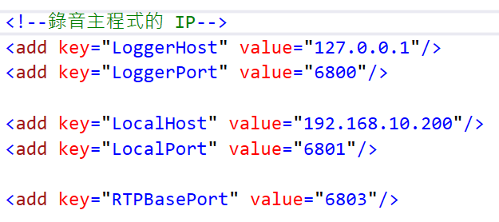
RTP封包架構：有 RtpGateway 的架構(舊)
urIprService.config
要安裝 VLC
ursVlcMonitor
(port 6801)
(port 6803)
RTP(127.0.0.1:6800)
urIprService
(Port 6800)
RTP(127.0.0.1:6805)
ursRtpGateway
(port 6805)
RTP(192.168.10.200:6803)
指到錄音主機的 IP
ursRtpGateway.config
指到錄音主機的 Port
Firewall:
UDP 6800 ~ 6805
AppSettings.config

Slide 3
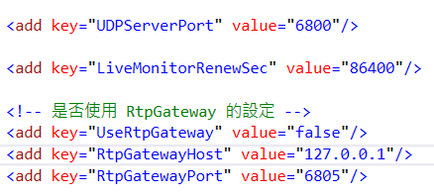
RTP封包架構：無 RtpGateway (舊)
ursVlcMonitor
(port 6801)
(port 6803)
RTP(127.0.0.1:6800)
urIprService
(Port 6800)
RTP(192.168.10.200:6803)
指到錄音主機的 IP
指到錄音主機的 Port

Slide 4
監聽的命令機制(舊)
API: GetChannelStatus
URS WEB
List<ChannelStatusViewModel>
SetAgentMonitor
(StartMon)
ursVlcMonitor
StartMon
Response
SetAgentMonitor
(StopMon)
顯示錯誤訊息
error
判斷回傳
Update tblModuleStatus.
MonitoredByAgentID = ‘’
DB
ok
Response
StopMon
30秒內如果沒有renew ，則停止監聽
開始VLC
監聽
urIprService_Cisco
(錄音主程式)
每 30 秒 renew 監聽 -> Send UDP : StartLiveMonitor
Renew
機制

Slide 5
UrsSipLogger WinForm 監聽架構(v2)
Account/Passwd
Local IP
UDP Port(tx/rx)
Extension No
Cmd=Start/Stop
Extension No
Cmd=Start/Stop
SipLiveMon
WinForm
UDP
LiveMon
GateWay
SipLogger
UDP
StatusCode
ResponseText
StatusCode
ResponseText
RTP
RTP

